Slide 1





Build your craft with Discover
Angel Diaz, VP Technology Capabilities & Innovation Sheila Lodhia, VP Application Development
+
+
+
=
The opinions expressed in this presentation are those of the presenter, in their individual

Slide 2
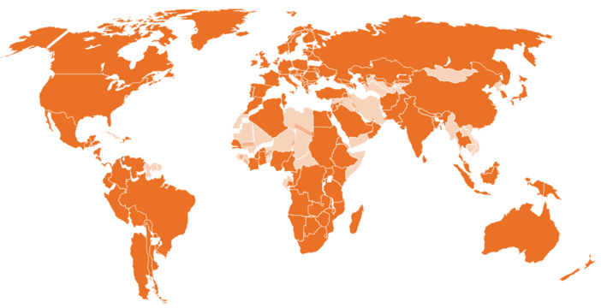



Discover Financial Services
Digital Banking
$71Bn in card receivables
$143Bn card sales volume
Leading cash rewards program $63Bn direct-to-consumer deposits
Cashback Checking and Debit
$10Bn private student loans
$7Bn personal loans
$2Bn home equity loans
Vision: To be the leading digital bank and payments partner
Mission: To help people spend smarter, manage debt better and save more so they achieve a brighter financial future.
VALUES
Doing the right thing
Innovation
Simplicity
Collaboration
Openness
Volunteerism
Enthusiasm
Respect
200+ Countries / Territories 50MM+ Merchant Locations ~2.2MM ATMs
$212Bn volume ~2.2MM ATMs in 140 countries /territories $24Bn volume Accepted in 200+ countries 50MM+ merchant locations $32MM volume 20+ network alliances
Focus 2021
1
2
3
4
Commitment to Diversity, Equity and Inclusion.
Accelerate Growth & Drive Efficiencies
Reduce Charge-offs
Grow Payments Business
Strengthen Foundation
©2021 Discover Financial Services - Confidential and Proprietary - Do not copy or distribute
Notes:
2

Slide 3
Agenda
Creating a Runway for Digital Transformation
Building our Craft with the Discover Technology Academy
Building our Products: Discover Dojo Case Studies
Building our communities, career and innovation
How we build our house together!
©2021 Discover Financial Services - Confidential and Proprietary - Do not copy or distribute

Slide 4

Shifts in technology has shaped the market landscape
_start
func1()
class
http://
Big Business
All Business
Corporations
Individuals
Weeks
Seconds
As technologists we have always fueled innovation … today is different
©2021 Discover Financial Services - Confidential and Proprietary - Do not copy or distribute

Slide 5
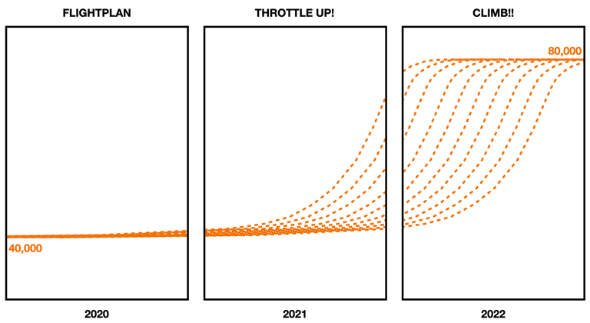
Creating a Runway for Digital Transformation
“I’d like to introduce you to The Runway: Mission 80K Feet," both in the spirit of the 'Dawn of Discover' and the early days of flight. Discover has built a strong brand, become a leading digital bank, achieved network acceptance parity, and developed a strong web and mobile presence . Through the Discover Management System and the Business Technology 2020 strategy Discover will elevate our craft and accelerate our Digital Transformation. " – Amir Arooni, CIO Discover Financial Services
Mission Runway 80,000 Feet will bring smaller, self-empowered product and engineering teams together that will focus on development in a single agile approach and automating manual functions with a strong emphasis on simplification.
©2021 Discover Financial Services - Confidential and Proprietary - Do not copy or distribute

Slide 6
The Discover Business Technology Academy
Build your Products
Build your Community
Build your Career
Innovate your Craft
Business innovation and product delivery are a team sport! The Discover Technology Academy is how you build your craft with Discover and achieve your runway Mission 80,000 FT goals!. The empoweres us to build great products, build communities, build your personal career, innovate at scale and have FUN!
©2021 Discover Financial Services - Confidential and Proprietary - Do not copy or distribute

Slide 7

“
With great power comes great responsibility... We take responsibility!
©2021 Discover Financial Services - Confidential and Proprietary - Do not copy or distribute

Slide 8
Becoming a product centric organization
Product & Organization Blueprint and Design
We deliver outcomes fast by shifting to a product organization structure powered by organization design, technology standards, methods, learning and community. The Organization Blueprint and Design is a set of best practices that describe the approach to perform organization and detailed design for a subset of the organization (wave) that is transforming to the product-centric Agile way of working.
Discover Dojo
Blueprint & Design
Customer Value
Product & Technology Standards
Product & Technology Standards come alive via Craftworx, the way we build products and deliver value to our clients. The massive amount of knowledge that is available within the organization is shared and Craftworx is the catalyst through which we can all collectively elevate in areas such as engineering lifecycle development. This elevation is shared and manifested through a variety of published mediums including code patterns, articles, tutorials, and blogs.
Discover Dojo
Community Standards
Discover Dojo is a service and a method of immersive learning and a holistic transformation model that enable costs optimization, speed, agility, and scale required to deliver a way forward for Discover’s Business Technology culture. The Discover Dojo service uses the Discover Dojo Methodology to bring to life Craftworx – Discover’s Software Development Lifecycle in support of our Agile way of Working.
©2021 Discover Financial Services - Confidential and Proprietary - Do not copy or distribute

Slide 9
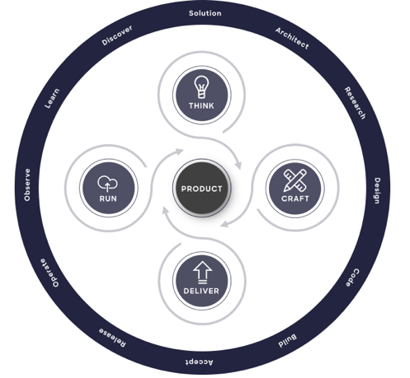
Product development is a team sport!
As product teams we love to deliver high-quality product experiences for our customers quickly. But a good digital product depends on more than just excellent code - it must fit in a customer's life and solve significant problems for them seamlessly. Our digital product lifecycle encompasses discovery of customer problems as well as creation, delivery and operation of products that solve them. Welcome to Craftworx – our approach to delivering products.
©2021 Discover Financial Services - Confidential and Proprietary - Do not copy or distribute

Slide 10

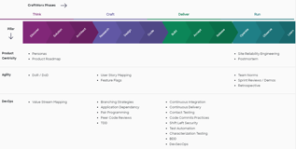
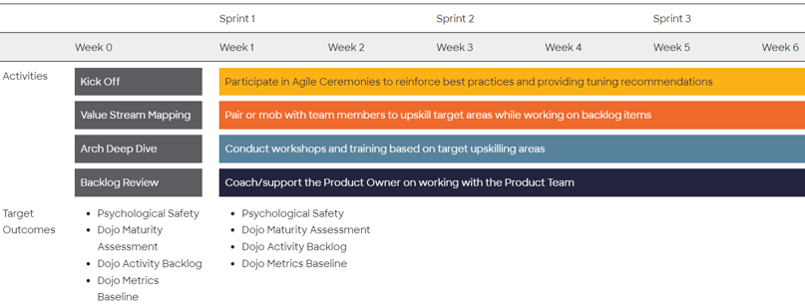
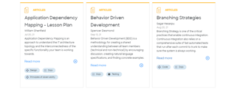

Our Discover Dojo Approach: Get your Mojo!
The Dojo helps Product Teams harden a set of core competencies, building a baseline of experience to grow from. Beyond the core competencies, the Dojo Experience is tailored to the team’s specific needs Meeting Teams Where They Are.
©2021 Discover Financial Services - Confidential and Proprietary - Do not copy or distribute

Slide 11
Each team continuously improves and are guided by metrics
For example DORA Metrics can help us Measure DevOps Performance …
1
2
3
4
5
Lead Time
Predictable Delivery
Deployment Frequency
Change Failure Rate
Mean Time to Restore
The time between task creation and work completed
Certainty for being able to complete a feature within a timeframe
How often the team can deploy to an environment
Reducing Escaped defects / Quality
Time taken to restore the feature in event of a failure.
Through our process we were able to help the teams understand, automate, measure and baseline current state and target states across of variety of metric types. Why does this matter? Speed to market, space to innovate, ability to incorporate more features, employee craftmapship.
©2021 Discover Financial Services - Confidential and Proprietary - Do not copy or distribute

Slide 12
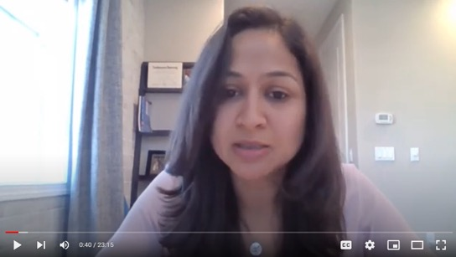
Team CAD: Customer & Account Data Team
Description Customer and Account data team is a platform team that owns some of the critical Customer and Account data related aggregators that serves data to all the customer journeys. This team has a goal to break apart these monolith legacy aggregators into domain-aligned APIs and federate them back to the product teams. Technology
From mainframe/WebSphere TO java/springboot microservices, cloud, MariaDB
Discover Dojo Focus Areas
Test-Driven Development (TDD) and Behavioral-Driven Development (BDD)
Definition of Ready & Definition of Done
Mob programming workshops
Incorporated feature flags & standardized branching
In our own words …
Priya Gupta Senior Manager Customer & Account Data
©2021 Discover Financial Services - Confidential and Proprietary - Do not copy or distribute

Slide 13
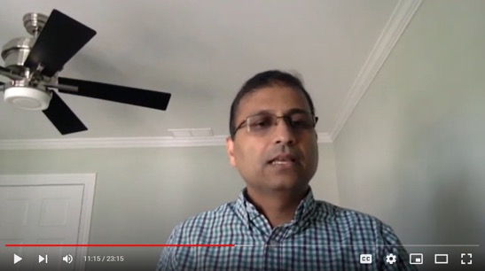
Team LIR: Line Increase Request Team
Description Line Increase Request provides the ability for card customers to request credit line increase through mobile, web and agent channels. LIR handles over 300,000 requests in a month and 98 % of requests get a decision instantly. Technology
From mainframe/WebSphere TO java/springboot microservices, cloud, MariaDB, React, JS
Discover Dojo Focus Areas
Small features and right size small stories
Test-Driven Development (TDD) and Behavioral-Driven Development (BDD)
Full CI/CD pipeline including metrics, security & SRE
In our own words …
Joe Mathew Senior Manager Line Increase Request
©2021 Discover Financial Services - Confidential and Proprietary - Do not copy or distribute

Slide 14
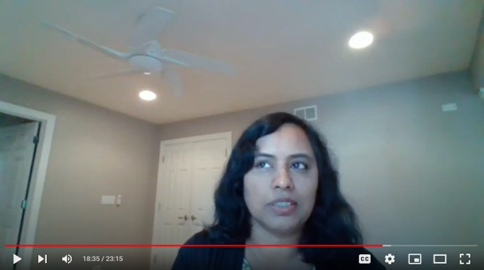
Team AUT: Authorized User Team
Description Authorized User team develops the technology, processes and interface for adding authorized users to accounts. On average, an AU adds $3,200 incremental sales on the account in the first year. Technology
From mainframe/WebSphere TO java/springboot microservices, cloud, MariaDB, React, JS
Discover Dojo Focus Areas
Focus on campaigns, UX optimizations and technology modernization.
Test-Driven Development (TDD) and Behavioral-Driven Development (BDD)
Resulted in dramatic increase of incremental authorized users, sales and application utilization.
In our own words …
Lakshmi Rupanagunta Manager Authorized User
©2021 Discover Financial Services - Confidential and Proprietary - Do not copy or distribute

Slide 15

“
When you learn, teach. When you get, give … We are good partners and develop others!
©2021 Discover Financial Services - Confidential and Proprietary - Do not copy or distribute

Slide 16
Building our community: Our Semantic Graph
For example: Application Engineering, IT Infrastructure, …
For example: Novice, Beginner, …
Role
Taxonomy
Competency Taxonomy
Indivdual
Every Discover Technology Academy eXperience piece of content and registered user will be tagged by role, competency, technology and content type – a strongly connected cyclic graph that will allow for the dynamic rending of relevant content and people for each individual.
Technology
Taxonomy
Content
Taxonomy
For example: CI/CD, Local Area Network, …
For example: Blog, Pattern, Learning Path, …
©2021 Discover Financial Services - Confidential and Proprietary - Do not copy or distribute

Slide 17

“
An investment in learning pays the best interest... We develop ourselves and stay ahead!
©2021 Discover Financial Services - Confidential and Proprietary - Do not copy or distribute

Slide 18
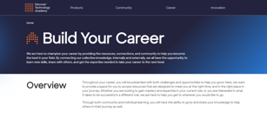
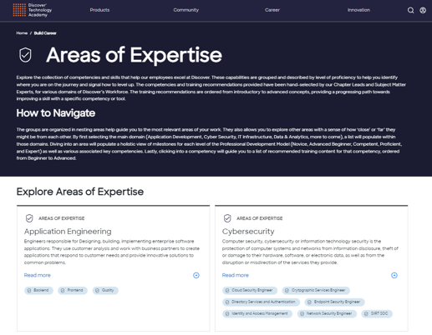
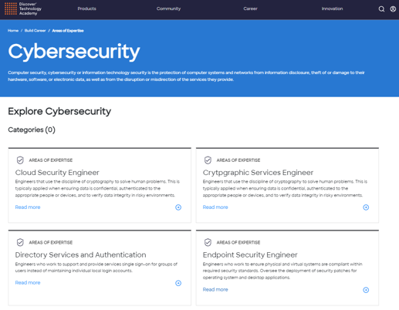


Building our career
Together we can skill up via learning paths and in context learning. We can explore and contribute to the communities, content, methods and standards – all while buffing our eminence and having fun!
©2021 Discover Financial Services - Confidential and Proprietary - Do not copy or distribute

Slide 19

“
Innovation is doing new things... We are curious, innovate and simplify!
©2021 Discover Financial Services - Confidential and Proprietary - Do not copy or distribute

Slide 20
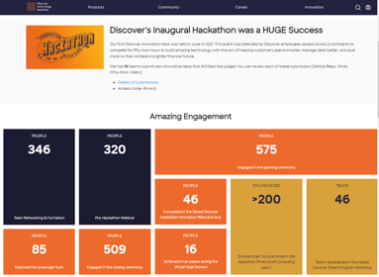
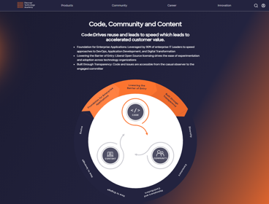
Building our innovation
“Hands on innovation grounded in product delivery paired with a culture of invention will help us build our Business and Technology Innovation Capability across Discover.” – Amir Arooni, Executive Vice President, CIO at Discover Financial Services
Together we: Build and contribute to our innovation design thinking methodology – Learn and contribute to the Discover Patent Program – Learn and participate in Discover Hackathons – Expand our knowledge by participating in external communities and open source.
©2021 Discover Financial Services - Confidential and Proprietary - Do not copy or distribute

Slide 21

“
It takes a village ... We build our house together!
©2021 Discover Financial Services - Confidential and Proprietary - Do not copy or distribute

Slide 22
“
We need your help as we build our house!
©2021 Discover Financial Services - Confidential and Proprietary - Do not copy or distribute

Slide 23
Thank You!
+
+
+
=
Build Products
Build Community
Build Career
Build Innovation
Build our Craft
We can’t wait to see what we build together!
©2021 Discover Financial Services - Confidential and Proprietary - Do not copy or distribute

